Slide 1
Docker - a surface skim
Piotr Wawrzyńczyk

Slide 2
What is Docker?
A tool that allows us to run applications in isolation, in a safe, portable and lightweight manner - by containerisation.
Notes:
value that it can bring for us - not going to deep into installation (Mac ok, Linux is native, WSL for Windows)
ain’t that VM?
why is it better?

Slide 3
What is Docker?
A tool that allows us to run applications in isolation, in a safe, portable and lightweight manner - by containerisation.
Unlike VM (that simulates a machine), container simulates an operating system - there comes the “lightweight” aspect.

Slide 4
What is Docker?
A tool that allows us to run applications in isolation, in a safe, portable and lightweight manner - by containerization.
Unlike VM (that simulates a machine), container simulates an operating system - there comes the “lightweight” aspect.
So how does this containerization work?

Slide 5
Containers
The system, dependencies, code and whatnot, packed into one bundle that can be run on the host machine.

Slide 6
Containers
The system, dependencies, code and whatnot, packed into one bundle that can be run on the host machine.
Are there any containers running in my system right now?
docker container ls
Notes:
isolation

Slide 7
Containers
The system, dependencies, code and whatnot, packed into one bundle that can be run on the host machine.
Are there any containers running in my system right now?
docker container ls
Let’s run a container!
docker run alpine:3.14.1 echo 'Hello world'
docker run --interactive --tty alpine:3.14.1
Notes:
isolation

Slide 8
Images
A template created from a set of instructions.

Slide 9
Images
A template created from a set of instructions, like:
Start from the specific version of a Linux system, add dependencies, install the target application and configure it.
We can compare it to a Git commit - only a set of changes.
Application (e.g. Express app)
Runtime environment (e.g. NodeJS)
An operating system (e.g. Linux Alpine)
Notes:
predecessor, layers
we can specify the version of a system, of dependencies etc
what is cool that we have

Slide 10
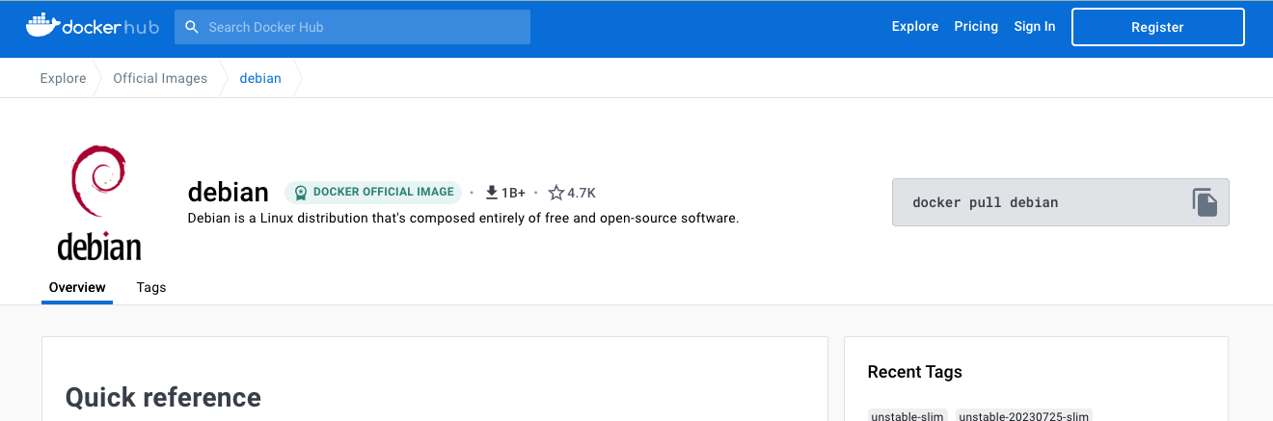
Where do the base images come from?
A Docker registry is a service that enables sharing the images.

Slide 11
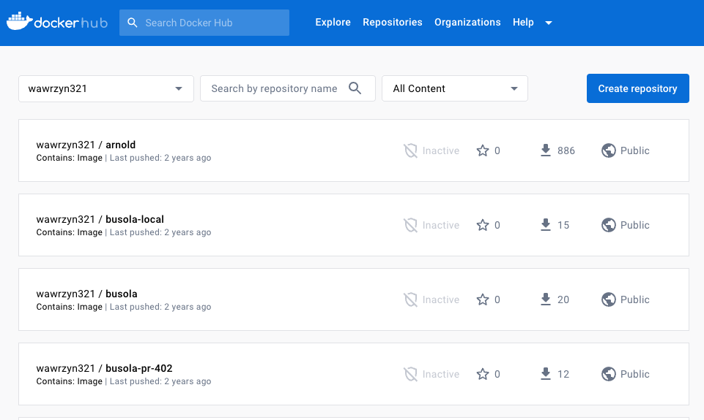
Where do the base images come from?
A Docker registry is a service that enables sharing the images.
We can share our images, too!
Notes:
predecessor, layers
we can specify the version of a system, of dependencies etc
what is cool that we have

Slide 12
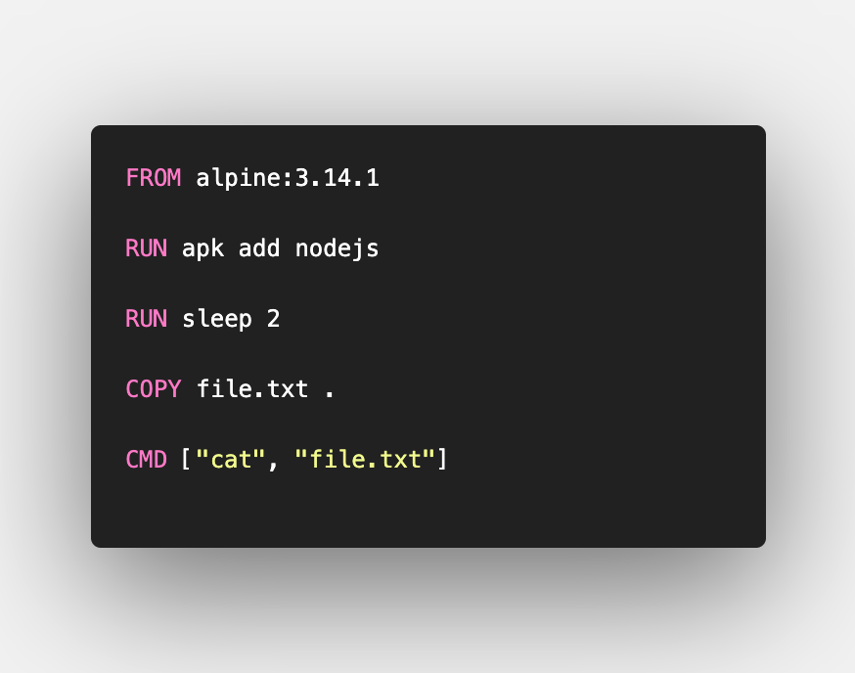
Dockerfile
Text file that defines how an image should be constructed.

Slide 13
Dockerfile
Text file that defines how an image should be constructed.
Building the image from a terminal:
docker build -t my-image:1.0 .
docker image ls

Slide 14
Maybe let’s see a more advanced example?
Then let’s see the next demo.
docker build -t node-app ./demo3
docker run node-app:latest ?

Slide 15
Maybe let’s see a more advanced example?
Then let’s see the next demo.
docker build -t node-app ./demo3
docker run node-app:latest
docker run -p 8080:8080 node-app:latest

Slide 16
What if we want to enter a running container?
Sure: docker exec –it <container id> <executable>
docker run <=> run the container + docker exec

Slide 17
What’s next?
Persistency - saving the data between container restarts → Docker volumes and bind mounts (or write to an external service)
Networking → docker network command
Running multiple images as single application → Docker Compose

Slide 18
Thanks!

